Slide 1


ALTSCHOOL OF Cybersecurity (BARAKA 2025)
Week 4

Slide 2
REFRESHER – WK 3 DAY2
Risk Assessment
Risk Assessment & Analysis
Risk Mitigation (Control Implementation)
Risk Monitoring & Detection
Incident Response & Recovery
Labs: Deployed VM an AWS and Created Sophos Central Account

Slide 3
Week 4 – DAY 1
Overview Legal Frameworks
  Introduction to key Legislation and Regulations (GDPR, HIPAA, CCPA, etc.)
    Importance of Data Protection and Privacy Laws
    The growing need for compliance in a digital world
    Understanding Data Privacy & Security Regulation
  Compliance Requirements and Standards
  Intellectual Property and Copyright Laws
Ethical Hacking
  Introduction to Ethical Hacking

Slide 4
Introduction to key Legislation and Regulations

Slide 5
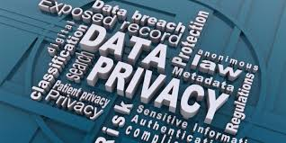
Introduction to key Legislation and Regulations
Importance of Data Protection and Privacy Laws - Data protection and privacy laws are essential in today’s digital world, where vast amounts of personal and sensitive information are collected, stored, and processed by organizations. These laws help safeguard individuals' rights, ensure businesses handle data responsibly, and protect against cyber threats and data misuse.

Slide 6
Introduction to key Legislation and Regulations
The growing need for compliance in a digital world - In today’s fast-evolving digital landscape, the need for organizations to comply with data protection and privacy regulations has become more critical than ever. The rapid expansion of digital technologies, cloud computing, and global connectivity has resulted in an unprecedented volume of data being created, shared, and stored. This transformation presents significant risks, making regulatory compliance essential to safeguard sensitive information and ensure business continuity.

Slide 7
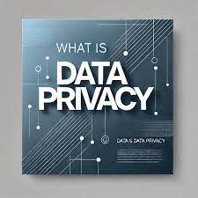
Introduction to key Legislation and Regulations
Understanding Data Privacy & Security Regulation- Data protection and privacy laws are legal frameworks designed to regulate how personal and sensitive information is collected, processed, stored, shared, and secured by organizations. These laws aim to protect individuals’ rights to privacy while ensuring that businesses handle data responsibly and securely.

Slide 8
Data Protection lAWS
Data Protection Laws
Data protection laws govern the security and management o personal data to prevent unauthorized access, misuse, or breaches. They establish guidelines for:
How organizations collect and store data
Who can access the data
How data should be transferred and protected
The security measures required to prevent breaches

Slide 9
DATA PRIVACY LAWS
Data Privacy Laws
Data privacy laws focus on ensuring that individuals have control over their personal information. These laws define:
The rights of individuals over their data (e.g., access, deletion, rectification)
The obligations of organizations in obtaining consent and being transparent
How data can or cannot be shared with third parties

Slide 10
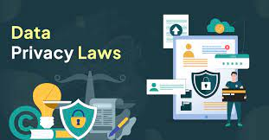
Why Regulations Exist?
Protecting Consumer Rights Data protection and privacy laws are legal frameworks designed to regulate how personal and sensitive information is collected, processed, stored, shared, and secured by organizations. These laws aim to protect individuals’ rights to privacy while ensuring that businesses handle data responsibly and securely.

Slide 11
Why Regulations Exist?
Key consumer rights under various privacy laws include:
Right to Access – Individuals can request to see what data an organization has collected about them (e.g., GDPR, CCPA).
Right to Correction/Rectification – Consumers can request corrections if their personal data is inaccurate or incomplete.
Right to Deletion (Right to Be Forgotten) – Consumers can request that their personal data be deleted under certain conditions (e.g., GDPR).
Right to Data Portability – Individuals can request their data in a structured format and transfer it to another service provider.
Right to Opt-Out of Data Collection and Processing – Consumers can refuse data collection for certain purposes, such as targeted advertising (e.g., CCPA, LGPD).
Right to Be Notified of Data Breaches – Organizations must inform consumers when a breach occurs that compromises their personal information.

Slide 12
Overview of Key Regulations and PENALTIES
General Data Protection Regulation (GDPR) (Europe):
Enforced: May 25, 2018
Scope: Protects the personal data of EU citizens
Penalties: Up to €20 million or 4% of global annual revenue
Health Insurance Portability and Accountability Act (HIPAA) (USA)
Enforced: 1996 (with updates)
Scope: Protects personal health information (PHI) in healthcare
Penalties: Up to $1.5 million per violation

Slide 13
Overview of Key Regulations and PENALTIES
Nigeria Data Protection Act (NDPA) 2023 (Nigeria):
Enforced: 2023
Scope: Protects the personal data of Nigerian citizens
Penalties: Up to 10 million or 2% of annual revenue for large organizations.
Ghana Data Protection Act, 2012 (Act 843)
Enforced: 2012
Scope: Protects the personal data of Ghana citizens
Penalties: Severe violations can result in fines up to GHS 30,000 ($2,500) or up to 10 years imprisonment.

Slide 14
Compliance Requirements and Standards

Slide 15
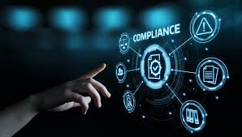
Legal and Regulatory Compliance
Obtain Consent: Organizations must get explicit consent before collecting or processing personal data. (E.g., GDPR, CCPA)
Data Subject Rights: Individuals have the right to access, correct, delete, or restrict the use of their personal data.
Breach Notification: In case of a data breach, organizations must notify regulatory authorities and affected individuals within the required timeframe (e.g., 72 hours under GDPR, 30 days under CCPA).
Lawful Data Processing: Data must be collected and processed for legitimate purposes only.

Slide 16
Security and Technical Controls
Data Encryption: Organizations must encrypt sensitive data to prevent unauthorized access.
Access Controls: Implement role-based access to ensure only authorized personnel can handle sensitive data.
Incident Response Plan: Companies must have a structured plan for responding to security incidents and breaches.
Data Minimization: Organizations should only collect and store the minimum amount of data necessary for business operations.

Slide 17
Organizational and Governance Policies
Appointing a Data Protection Officer (DPO): Required for organizations that handle large amounts of personal data (e.g., GDPR, Kenya’s Data Protection Act).
Employee Training: Staff must be trained on data protection policies and best practices.
Third-Party Vendor Compliance: Businesses must ensure that vendors handling their data comply with relevant regulations.
Regular Audits: Companies must conduct periodic assessments to ensure compliance with data protection laws.

Slide 18
Organizational and Governance Policies
Appointing a Data Protection Officer (DPO): Required for organizations that handle large amounts of personal data (e.g., GDPR, Kenya’s Data Protection Act).
Employee Training: Staff must be trained on data protection policies and best practices.
Third-Party Vendor Compliance: Businesses must ensure that vendors handling their data comply with relevant regulations.
Regular Audits: Companies must conduct periodic assessments to ensure compliance with data protection laws.

Slide 19
International Compliance Standards
Beyond national laws, businesses often follow global data protection and security standards to demonstrate compliance and improve data governance.
A. Data Privacy Frameworks
  General Data Protection Regulation (GDPR - EU): One of the world’s most comprehensive data privacy laws, requiring organizations to protect EU citizens' personal data.
  California Consumer Privacy Act (CCPA - USA): Provides California residents with rights over their data and imposes obligations on businesses handling their information.
  Nigeria Data Protection Act (NDPA 2023): Sets data processing requirements for businesses in Nigeria, ensuring transparency and security.
  Kenya Data Protection Act (2019): Regulates data processing activities and enforces privacy rights in Kenya.
  Ghana Data Protection Act (2012): Governs how personal data is collected, processed, and stored within Ghana.

Slide 20
International Compliance Standards
B. Information Security Standards
  ISO/IEC 27001 (International Security Standard): A globally recognized framework for managing information security risks.
  NIST Cybersecurity Framework (USA): A risk-based approach to managing cybersecurity threats.
  PCI DSS (Payment Card Industry Data Security Standard): Protects payment card information by enforcing strict security measures for financial transactions.
  SOC 2 (Service Organization Control): Ensures that cloud-based service providers maintain high levels of data security and privacy.

Slide 21
International Compliance Standards
C. Industry-Specific Regulations
  HIPAA (Health Insurance Portability and Accountability Act - USA): Protects patient health information in the healthcare industry.
  GLBA (Gramm-Leach-Bliley Act - USA): Requires financial institutions to safeguard customer financial data.
  FISMA (Federal Information Security Management Act - USA): Governs cybersecurity measures for government agencies and contractors.

Slide 22
Intellectual Property and Copyright Laws

Slide 23
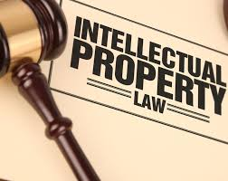
Understanding Intellectual Property (IP)
Intellectual Property (IP) refers to intangible creations of the mind, such as inventions, artistic works, brand names, trade secrets, and proprietary technology. IP laws grant legal protection to these creations, ensuring that their owners can benefit from their use and prevent unauthorized exploitation.

Slide 24
Types of Intellectual Property
Copyright: Protects literary, artistic, and creative works such as books, music, films, and software.
Patents: Grants exclusive rights to inventors for new inventions, preventing others from making, using, or selling them without permission.
Trademarks: Protects brand names, logos, slogans, and distinctive signs used in commerce.
Trade Secrets: Covers confidential business information, formulas, processes, or practices that give a company a competitive edge.
Industrial Designs: Protects the aesthetic or ornamental aspects of a product, such as its shape, color, or pattern.

Slide 25
Class work
Sophos labs and AWS

Slide 26
REFRESHER - Wk DAY1
Overview Legal Frameworks
  Introduction to key Legislation and Regulations (GDPR, HIPAA, CCPA, etc.)
    Importance of Data Protection and Privacy Laws
    The growing need for compliance in a digital world
    Understanding Data Privacy & Security Regulation
  Compliance Requirements and Standards
  Intellectual Property and Copyright Laws

Slide 27
Week 4 – DAY 2
Ethical Hacking
  Introduction to Ethical Hacking
    Fundamental Security and Hacking Concepts
Privacy and Data Protection Ethics
Cybersecurity Policy Development
Roles of Professional Organizations (ISC2, ISACA, SANS)

Slide 28
INTRODUCTION TO ETHICAL HACKING

Slide 29
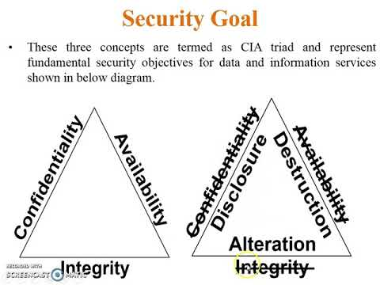
Fundamental security concepts
In addition to the CIA triad, other properties, such as authenticity, accountability, non-repudiation and reliability can also be involved.
Authenticity Refers to the characteristic of a communication, document, or any data that ensures the quality of being genuine
Auditing & Accountability Basically keep tracking of every thing, like, who's been logging in when are they login in whose access this data.
Non-Repudiation is the assurance that someone cannot deny the validity of something. Non-repudiation is a legal concept that is widely used in information security and refers to a service, which provides proof of the origin of data and the integrity of the data.

Slide 30
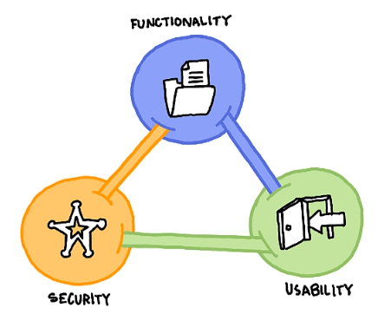
Security, Functionality and Usability balance
There is an inter dependency between these three attributes. When security goes up, usability and functionality come down. Any organization should balance between these three qualities to arrive at a balanced information system

Slide 31
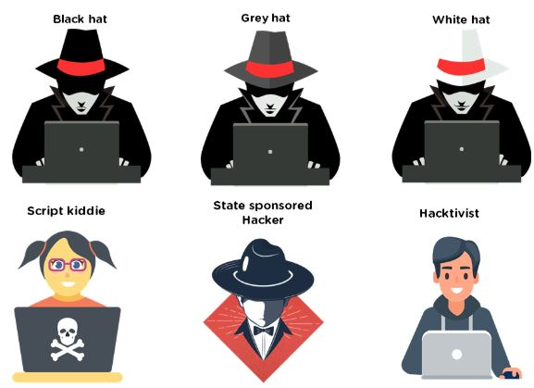
Types of Hackers
Refresher…
Black Hat - Hackers that seek to perform malicious activities.
Gray Hat - Hackers that perform good or bad activities but do not have the permission of the organization they are hacking against.
White Hat - Ethical hackers; They use their skills to improve security by exposing vulnerabilities before malicious hackers.

Slide 32
Types of ATTACKERs
Let’s talk about others attackers.
Script Kiddie / Skiddies - Unskilled individual who uses malicious scripts or programs, such as a web shell, developed by others to attack computer systems and networks and deface websites.
State-Sponsored Hacker - Hacker that is hired by a government or entity related.
Hacktivist - Someone who hacks for a cause; political agenda.
Suicide Hackers - Are hackers that are not afraid of going jail or facing any sort of punishment; hack to get the job done.
Cyberterrorist - Motivated by religious or political beliefs to create fear or disruption.

Slide 33
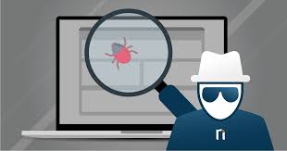
HACKING VOCABULARY
Hack value - Perceived value or worth of a target as seen by the attacker.
Vulnerability - A system flaw, weakness on the system (on design, implementation etc).
Threat - Exploits a vulnerability.
Exploit - Exploits are a way of gaining access to a system through a security flaw and taking advantage of the flaw for their benefit.
Payload - Component of an attack; is the part of the private user text which could also contain malware such as worms or viruses which performs the malicious action; deleting data, sending spam or encrypting data.
Zero-day attack - Attack that occurs before a vendor knows or is able to patch a flaw.
Daisy Chaining / Pivotting - It involves gaining access to a network and /or computer and then using the same information to gain access to multiple networks and computers that contains desirable information.
Doxxing - Publishing PII about an individual usually with a malicious intent.
Enterprise Information Security Architecture (EISA) - determines the structure and behavior of organization's information systems through processes, requirements, principles and models.

Slide 34
Threat Categories
Network Threats | Host Threats | Application Threats
Information gathering Sniffing and eavesdropping DNS/ARP Poisoning MITM (Man-in-the-Middle Attack) DoS/DDoS Password-based attacks Firewall and IDS attack Session Hijacking | Password cracking Malware attacks Footprinting Profiling Arbitrary code execution Backdoor access Privilege Escalation Code Execution | Injection Attacks Improper data/input validation Improper error handling and exeception management Hidden-field manipulation Broken session management Cryptography issues SQL injection Phishing Buffer Overflow Information disclosure Security Misconfigurations

Slide 35
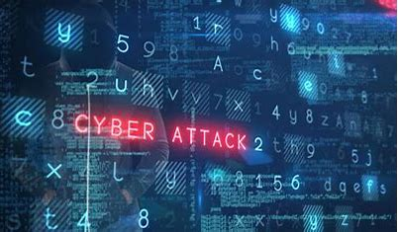
Some Attack Vectors
Path by which a hacker can gain access to a host in order to deliver a payload or malicious outcome
APT - Advanced Persistent Threats
  An advanced persistent threat is a stealthy threat actor, typically a nation state or state-sponsored group, which gains unauthorized access to a computer network and remains undetected for an extended period; Typically uses zero-day attacks.
Cloud computing / Cloud based technologies
  Flaw in one client's application cloud allow attacker to access other client's data
Ransomware
  Restricts access to the computer system's files and folders and demands an online ransom payment to the attacker in order to remove the restrictions.
Web Application Threats
  Attacks like SQL injection, XSS (Cross-site scripting)...

Slide 36
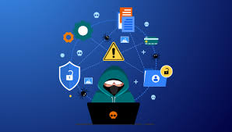
Vulnerability Categories
Misconfiguration - improperly configuring a service or application
Default installation - failure to change settings in an application that come by default
Buffer overflow - code execution flaw
Missing patches - systems that have not been patched
Design flaws - flaws inherent to system design such as encryption and data validation
Operating System Flaws - flaws specific to each OS
Default passwords - leaving default passwords that come with system/application

Slide 37
Pen Test Phases
Pre-Attack Phase - Reconnaissance and data-gathering.
Attack Phase - Attempts to penetrate the network and execute attacks.
Post-Attack Phase - Cleanup to return a system to the pre-attack condition and deliver reports.

Slide 38

STAGES IN ETHICAL HACKING
Reconnaissance
Gathering evidence about targets; There are two types of Recon:
  Passive Reconnaissance: Gain information about targeted computers and networks without direct interaction with the systems. e.g: Google Search, Public records, New releases, Social Media, Wardrive scanning networks around.
  Active Reconnaissance: Envolves direct interaction with the target. e.g: Make a phone call to the target, Job interview; tools like Nmap, Nessus, OpenVAS, Nikto and Metasploit can be considered as Active Recon.

Slide 39
STAGES IN ETHICAL HACKING
Scanning & Enumeration
Obtaining more in-depth information about targets. e.g: Network Scanning, Port Scanning, Which versions of services are running.

Slide 40
STAGES IN ETHICAL HACKING
Gaining Access
Attacks are leveled in order to gain access to a system
  e.g: Can be done locally (offline), over a LAN or over the internet.
  e.g(2): Spoofing to exploit the system by pretending to be a legitimate user or different systems, they can send a data packet containing a bug to the target system in order to exploit a vulnerability. Can be done using many techniques like command injection, buffer overflow, DoS, brute forcing credentials, social engineering, misconfigurations etc.

Slide 41
STAGES IN ETHICAL HACKING
Gaining Access
Maintaining Access - Items put in place to ensure future access. e.g: Rookit, Trojan, Backdoor can be used.

Slide 42
STAGES IN ETHICAL HACKING
Covering Tracks
Steps taken to conceal success and intrusion; Not be noticed.
  e.g: Clear the logs; Obfuscate trojans or malicious backdoors programs.

Slide 43
Privacy and Data Protection Ethics

Slide 44
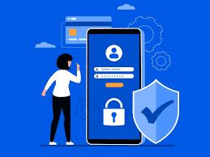
Privacy and Data Protection Ethics
Vast amounts of personal and sensitive data are collected, processed, and shared by organizations. Privacy and Data Protection Ethics focus on ensuring that individuals' data is handled responsibly, transparently, and securely. Ethical data practices go beyond legal compliance, fostering trust between organizations and individuals while preventing misuse or exploitation of personal information.
Ethical privacy and data protection principles emphasize fairness, transparency, accountability, and respect for individual rights. Organizations must balance their need to collect data with individuals' rights to privacy and autonomy.

Slide 45
Understanding Privacy and Data Protection Ethics
Key ethical considerations include:
  Respect for Individual Autonomy – People should have control over their personal data and the right to decide how it is used.
  Transparency and Honesty – Organizations must clearly inform users about what data is collected, how it is used, and with whom it is shared.
  Fair and Lawful Data Processing – Data should be collected and processed for legitimate, ethical, and legal purposes.
  Data Minimization – Only necessary data should be collected and retained for the minimum required duration.
  Security and Confidentiality – Organizations must implement strong cybersecurity measures to protect personal data from breaches and unauthorized access..

Slide 46
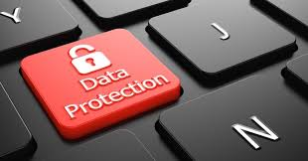
Ethical Principles in Privacy and Data Protection
A. Informed Consent - Individuals must be given clear, understandable choices about data collection. They should be able to opt in or out without coercion. Example: Websites should not use pre-checked consent boxes that force users to share data.
B. Right to Access and Control - People should be able to access their personal data, correct inaccuracies, or request its deletion. Example: GDPR’s Right to Be Forgotten allows individuals to request the removal of their data from online platforms.

Slide 47
Ethical Principles in Privacy and Data Protection
C. Accountability and Responsibility - Organizations must take responsibility for ethical data handling and be prepared to justify their data practices. Example: Companies should conduct Data Protection Impact Assessments (DPIAs) before launching new data-driven services.
D. Fairness and Non-Discrimination - AI-driven systems and data analytics should not be used to unfairly discriminate against individuals based on race, gender, or other sensitive attributes. Example: Hiring algorithms should be audited to ensure they do not unfairly reject job applicants based on biased training data.

Slide 48
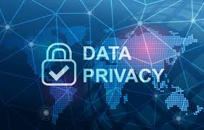
Ethical Challenges in Privacy and Data Protection
Surveillance and Tracking
Ethical dilemma: Governments and businesses use data tracking technologies for security and marketing, but this can invade personal privacy.
  Solution: Organizations should implement privacy-by-design strategies and limit data collection to what is essential.
AI and Data Ethics
Ethical dilemma: AI systems process massive amounts of personal data, raising concerns about bias, fairness, and informed consent.
  Solution: AI developers should apply fairness and transparency principles in training models and avoid excessive data retention.

Slide 49
Ethical Challenges in Privacy and Data Protection
Cybersecurity and Data Breaches
Ethical dilemma: Organizations collecting vast data are responsible for securing it against hackers, but many fail to prioritize security.
  Solution: Strong encryption, regular security audits, and zero-trust security models should be implemented.

Slide 50
Cybersecurity Policy Development

Slide 51
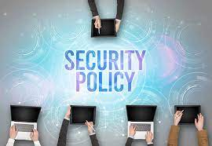
CYBERSECURITY POLICY
A Cybersecurity Policy is a structured set of guidelines that define how an organization protects its information systems, networks, and data from cyber threats. It provides employees, partners, and stakeholders with clear rules and procedures to ensure the confidentiality, integrity, and availability of information assets.
Developing a comprehensive cybersecurity policy is essential to protect against data breaches, cyberattacks, and compliance violations.

Slide 52
Importance of Cybersecurity Policy
A well-defined cybersecurity policy:
  Sets clear security expectations for employees and third parties.
  Mitigates risks by defining preventive and response measures.
  Ensures regulatory compliance with laws like GDPR, NDPA, HIPAA, and ISO 27001.
  Enhances incident response readiness by outlining breach handling procedures.
  Builds cybersecurity culture within an organization.

Slide 53
Key Components of a Cybersecurity Policy
Purpose and Scope
Defines the objectives of the policy.
Specifies which departments, employees, and systems it applies to.
Identifies legal and regulatory frameworks governing security.
  .

Slide 54
Key Components of a Cybersecurity Policy
Roles and Responsibilities
Assigns cybersecurity duties to different teams, such as:
IT Security Team – Responsible for monitoring threats and implementing controls.
Employees – Must follow security best practices (e.g., strong passwords, phishing awareness).
Management – Ensures compliance and resource allocation.
  .

Slide 55
Key Components of a Cybersecurity Policy
Compliance and Legal Considerations
Aligns with global and local cybersecurity laws (GDPR, NDPA, ISO 27001, CCPA).
Specifies penalties for violating security policies.

Slide 56
Key Components of a Cybersecurity Policy
Security Awareness and Training
Employees must undergo regular cybersecurity training.
Conduct phishing simulation tests to improve awareness.

Slide 57
Types of a Cybersecurity Policy
Access Control and Authentication
Defines who can access what data and under what conditions.
Enforces Multi-Factor Authentication (MFA) for sensitive systems.
Implements role-based access control (RBAC) to limit unnecessary access.
  .

Slide 58
Types of a Cybersecurity Policy
Data Protection and Encryption
Requires encryption of sensitive data (e.g., AES-256, TLS).
Specifies data retention and disposal policies.
Implements backup procedures to prevent data loss.
  .

Slide 59
Types of a Cybersecurity Policy
Network and Endpoint Security
Mandates use of firewalls, intrusion detection systems (IDS), and VPNs.
Ensures patch management for operating systems and applications.
Establishes guidelines for securing remote work and BYOD (Bring Your Own Device) policies.
  .

Slide 60
Types of a Cybersecurity Policy
Incident Response and Reporting
Defines steps for detecting, responding, and recovering from cyber incidents.
Requires employees to report suspicious activities immediately.
Includes business continuity and disaster recovery (BCDR) plans.

Slide 61
Types of a Cybersecurity Policy
Acceptable Use Policy (AUP)
Defines what employees can and cannot do with corporate systems and data.
Covers rules for social media, personal device usage, and email security.

Slide 62
Cybersecurity Policy Development Process
Assess Risks and Requirements
Define Policy Objectives
Draft the Policy
Review and Approve
Implement and Train Employees
Monitor and Update

Slide 63
Roles of Professional Organizations in Cybersecurity

Slide 64
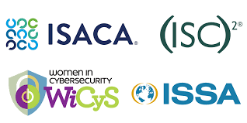
ROLES OF PROFESSIONAL BODIES
Professional organizations like SANS Institute (SANS), Information Systems Audit and Control Association (ISACA), and International Information System Security Certification Consortium (ISC²) play a critical role in shaping cybersecurity standards, advancing industry knowledge, and supporting professionals through certifications, training, and best practices.

Slide 65
ISACA
Information Systems Audit and Control Association (ISACA), is a globally recognized professional organization that focuses on IT governance, risk management, cybersecurity, and auditing. It supports professionals in managing and securing information systems through certifications, frameworks, and networking opportunities.

Slide 66
KEY ROLES
IT Governance and Risk Management – Develops frameworks like COBIT (Control Objectives for Information and Related Technologies) for IT governance.
Cybersecurity and Audit Standards – Establishes security and compliance standards for IT audit, cybersecurity, and risk assessment.
Certifications and Career Development – Offers industry-leading credentials to validate expertise in information security, risk management, and governance.
Research and Publications – Publishes reports on emerging cyber threats, IT governance trends, and audit best practices.
Conferences and Workshops – Organizes global events like ISACA Cybersecurity Nexus (CSX) for professional networking and skill development.

